Slide 1


Slide 2
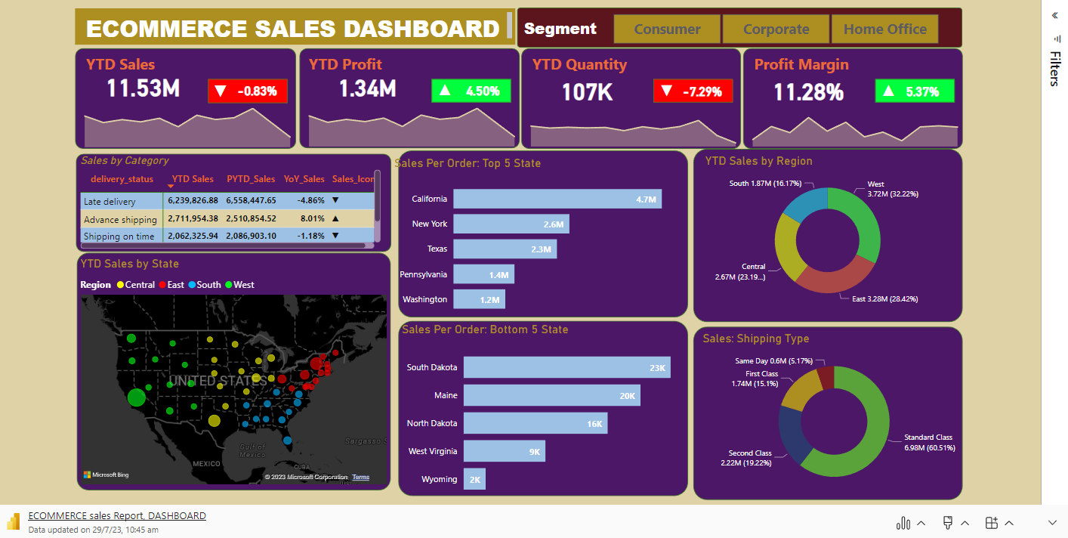
Explore Live Data Visuals: Connected to the Source

Slide 3

INTRODUCTION
In this report, we present the sales insights obtained from a comprehensive Power BI dashboard analysis for your Ecommerce company. The data provides a clear understanding of the company's performance, highlighting key metrics such as YTD sales, profit, quantity, and profit margin. Additionally, we have analysed YoY comparisons and sales performance by delivery status, state, region, and shipping type. These insights will serve as valuable indicators of the company's success and areas for improvement.

Slide 4

YTD Sales and Profit:
The year-to-date (YTD) sales stand at an impressive 11.53 million, showcasing the company's strong revenue performance.
Concurrently, YTD profit amounts to 1.34 million, indicating efficient cost management and healthy financial results.
The YTD quantity of 107K signifies the volume of goods sold during the current period, showcasing a steady flow of sales.

Slide 5
Profit Margin:
The company's profit margin stands at a commendable 11.28%, highlighting its ability to generate profit relative to sales revenue.

Slide 6
Year-on-Year (YoY)
Performance:
While there has been a slight reduction of 0.83% in sales from the previous year to the current year, the company remains competitive in a dynamic market.
On the positive side, there is a notable increase of 4.5% in profit, indicating successful business strategies in optimizing profitability.
Despite a reduction of 7.29% in quantity, the company's profit margin shows an encouraging rise of 5.37%, reflecting effective cost controls.

Slide 7
Sales by Delivery Status:
Late delivery sales for the YTD period amount to 6.24 million, with a YoY decline of 4.86%.
Advance shipping records 2.71 million in sales, showcasing an 8.01% YoY increase.
Shipping on time captures 2.06 million in sales, with a marginal decline of 1.18% YoY.
Shipping cancellations amount to 519,533 in sales, experiencing a YoY increase of 9.65%.

Slide 8
Top 5 and Bottom 5 States by Sales per Order:
California leads with 4.17 million in sales per order, followed by New York with 2.6 million, and Texas with 2.3 million.
Pennsylvania records 1.4 million in sales per order, and Washington follows closely with 1.2 million.
In contrast, South Dakota has the lowest sales per order with 23K, with Maine at 20K, North Dakota at 16K, West Virginia at 9K, and Wyoming at 2K.

Slide 9
YTD Sales by Region:
The South region accounts for 1.87 million in sales (16.17% of total YTD sales).
The West region records 3.72 million in sales (32.22% of total YTD sales).
The Central region captures 2.67 million in sales (23.19% of total YTD sales).
The East region showcases 3.28 million in sales (28.42% of total YTD sales).

Slide 10
Sales by Shipping Type:
First class shipping contributes 1.74 million in sales (15.1% of total sales).
Second class shipping records 2.22 million in sales (19.22% of total sales).
Standard class shipping leads with 6.98 million in sales (60.51% of total sales).
First class shipping accounts for 1.74 million in sales (15.1% of total sales).

Slide 11
How to Increase Sales: -
Improve Delivery Efficiency:
The data shows a YoY decline in late delivery sales, indicating a potential area for improvement. By streamlining logistics, optimizing supply chain management, and offering expedited shipping options, the client can enhance delivery efficiency. This will lead to higher customer satisfaction and loyalty, ultimately driving increased sales.
Targeted Marketing Strategies:
To capitalize on top-performing states and boost sales in bottom-performing states, the client can implement targeted marketing strategies. Allocating additional marketing resources to strong-performing states and tailoring advertising campaigns to resonate with local preferences can further strengthen the client's market presence. For states with lower sales, market penetration efforts and personalized promotions could be deployed to attract potential customers.

Slide 12
Enhance Product Offerings and Personalization:
The client can explore opportunities to expand and diversify their product offerings. By introducing new products or variations of existing ones, they can cater to a broader customer base and capture niche markets. Additionally, offering personalized experiences, such as personalized recommendations and targeted promotions based on customer preferences, can create a more engaging shopping journey, driving customer loyalty and repeat sales.
Utilize Sales by Shipping Type Insights:
Analyzing sales by shipping type reveals that standard class shipping accounts for the majority of sales. The client can leverage this insight to optimize shipping options and pricing. Offering free or discounted standard shipping for certain order values may incentivize customers to spend more, further boosting sales.

Slide 13
Capitalize on Profit Margin Increase:
The YoY increase in profit margin indicates effective cost management. The client can use this positive performance to reassess pricing strategies and explore opportunities to maintain or increase product prices without compromising customer value. Strategic price adjustments can positively impact overall revenue and profitability.
Leverage Regional Sales Insights:
By understanding the sales distribution across regions, the client can tailor marketing efforts and product assortments to cater to regional preferences and demands. Investing in regional-specific marketing campaigns and promotions can yield better results and increase sales in each target region.

Slide 14
CONCLUSION
In conclusion, the data provides valuable insights that can guide the client in increasing sales. By focusing on delivery efficiency, targeted marketing, product offerings, personalization, shipping strategies, and regional considerations, the client can enhance their market position and drive sales growth. Regular monitoring and data analysis will be essential to measure the impact of implemented strategies and make data-driven decisions for continued success.

Slide 15
THANKYOU

